Slide 1

Module 9 – Shiny Easy Web Apps in R

Slide 2

Outline
What is Shiny?
Why use Shiny?
How to Use Shiny?

Slide 3
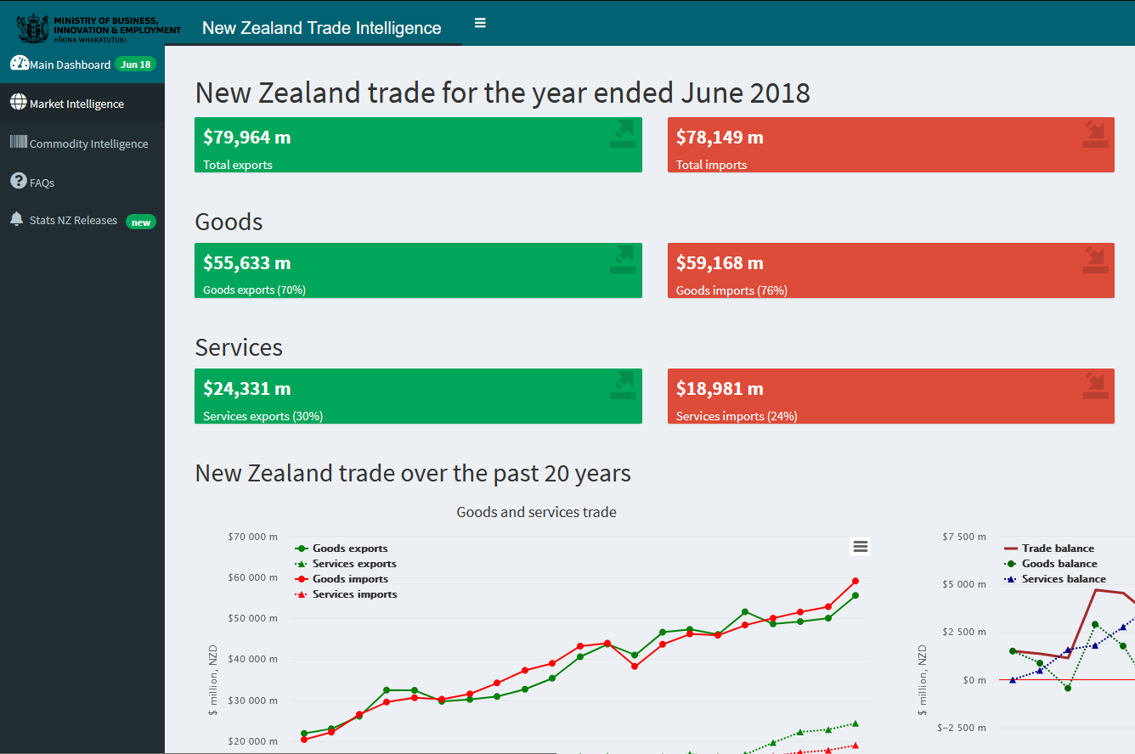
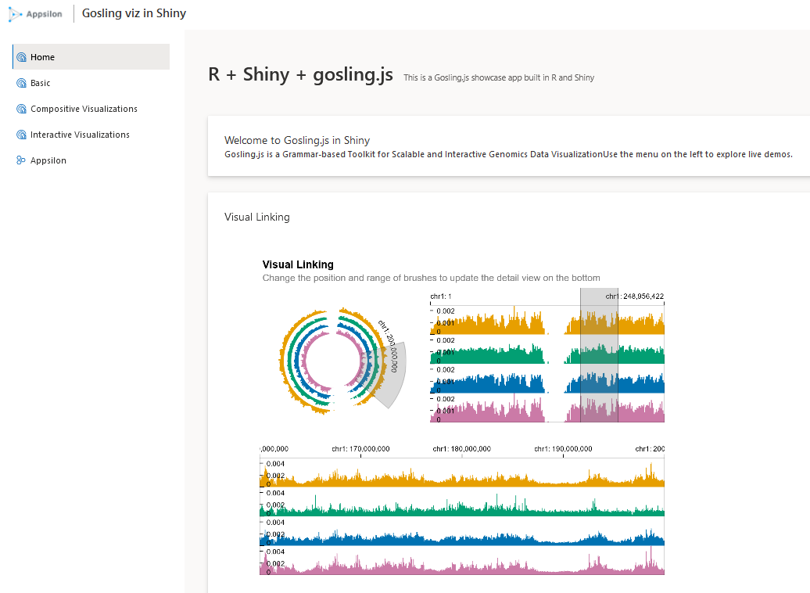
What is Shiny?
Shiny is an open source R package.
Shiny provides a framework for building web applications using R.
leverage existing knowledge of R packages within Shiny apps
do not need to learn HTML, CSS, JavaScript, etc.

Slide 4

Example App
https://shinylaurel.com

Slide 5
Why use Shiny?
share information with others
Share results with your lab group
Quickly generate graphs, tables, and other output
while allowing your users to filter what data they see
Passwords can be used to control access to a Shiny app on the web
Share results with the world
When publishing a paper
a companion app can help readers become more interested in your work
and more quickly interact with data
https://aguimaraesduarte.github.io/WorldBank-Shiny/

Slide 6
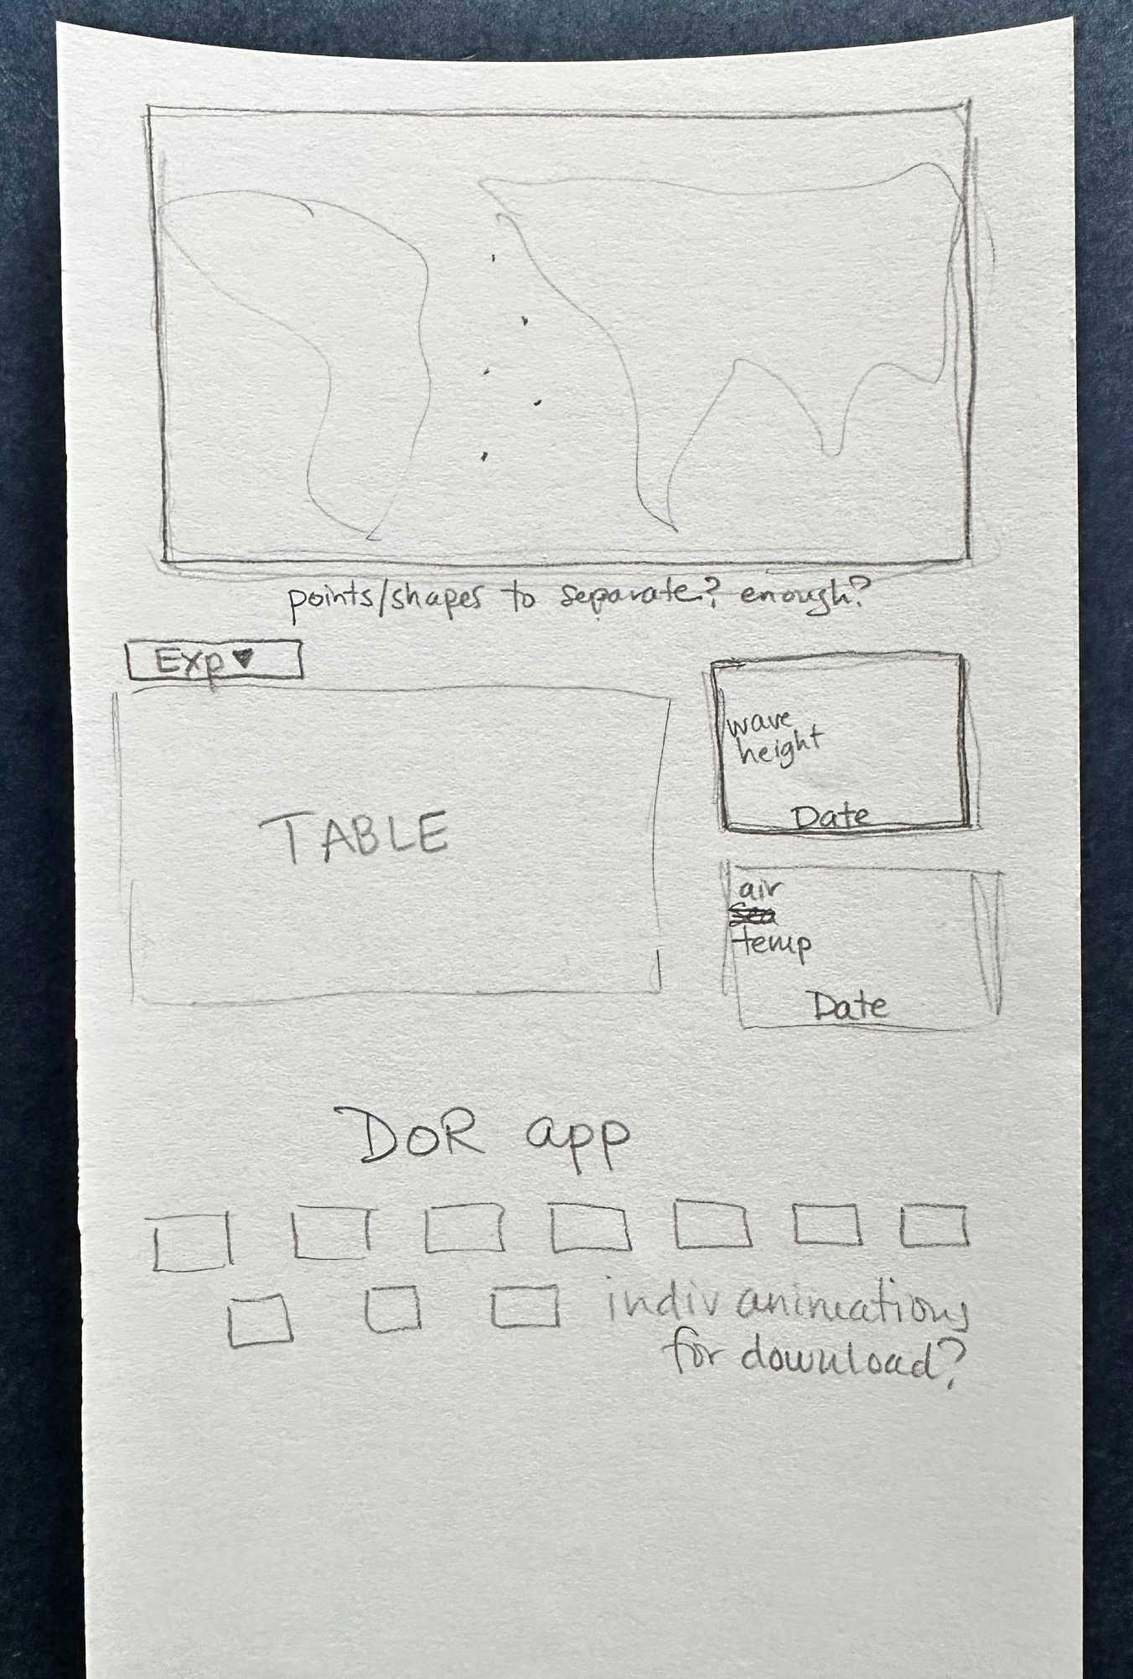
HOW TO USE SHINY - fundamentals
Design before you start to type!
Look for inspiration in examples (see later slide for links)
Build one piece at a time. This will make troubleshooting easier.
What I show you today is my way of doing it – as with all things in R there are at least 3+ other ways of doing it. Find what works for you!
We will only look at a very small set of the capabilities of Shiny today

Slide 7
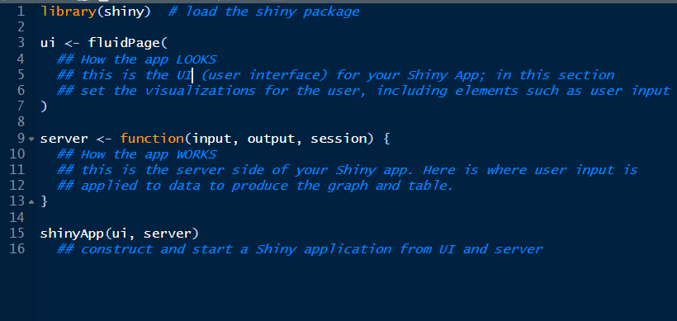
Structure of a Shiny App – SEE Detailed Workflow PDF

Slide 8
Publishing Your Shiny App
shinyapps.io
https://www.shinyapps.io/
Free for up to 5 apps & 25 active hours
E-A-S-Y
Integrated seamlessly into Rstudio
https://shiny.posit.co/r/articles/share/shinyapps/
An easy way to start and determine if you want to keep going with Shiny
Build Your Own Shiny Server
Shiny Server is a product by RStudio that lets you host apps on your own server
more freedom and flexibility
need to have a server
need to be your own server admin
You can do it!

Slide 9
Links to Shiny Tutorials, Demos, etc.
Learn (more) Shiny
Shiny – Main Tutorial
Also in Python!
Mastering Shiny
Michigan State
LinkedIn Learning
Dean Attali Tutorial
Build Your Own Shiny Server
Examples & Example Code
Shiny Gallery
Life Sciences Examples
Appsilon
RStudio GitHub Shiny Example Code

Slide 10

THANK YOU
Laurel Childress
childress@iodp.tamu.edu
https://shinylaurel.com

